Slide 1

Instructor: Mr. Saeed
Customer Lifetime Value Prediction using Linear Regression
Prepared by: Mishal Nadeem
2023-BSAI-020

Slide 2
Introduction
This project aims to predict Customer Lifetime Value (CLV) using a linear regression model. It involves comprehensive data preprocessing such as outlier handling, standardization, and one-hot encoding. After selecting important features and splitting the data, a linear regression algorithm is applied. The model’s performance is evaluated through error metrics and visualizations, offering insights into how individual features impact customer value. This study highlights the practical use of linear regression in customer analytics

Slide 3
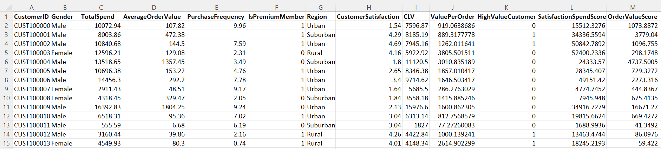
Dataset: Customer Lifetime Value
The dataset consists of 1,000 rows and 13 columns, aimed at analyzing customer behavior, spending patterns, and factors influencing Customer Lifetime Value (CLV). It includes a mix of categorical and numerical features such as gender, total spend, purchase frequency, satisfaction scores, and membership status. The target variable is CLV, representing the predicted value a customer will contribute over time.

Slide 4
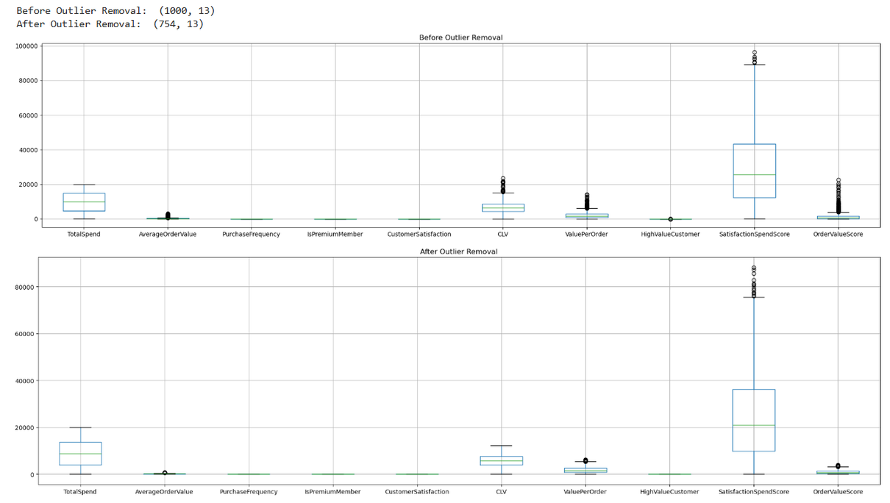
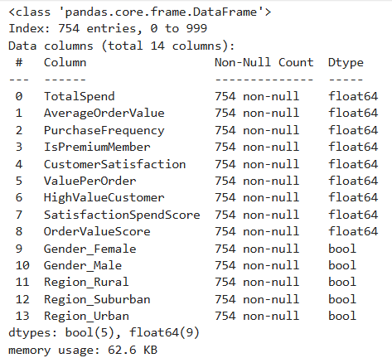
Data Preprocessing
Outlier Removal
One-hot Encoding

Slide 5
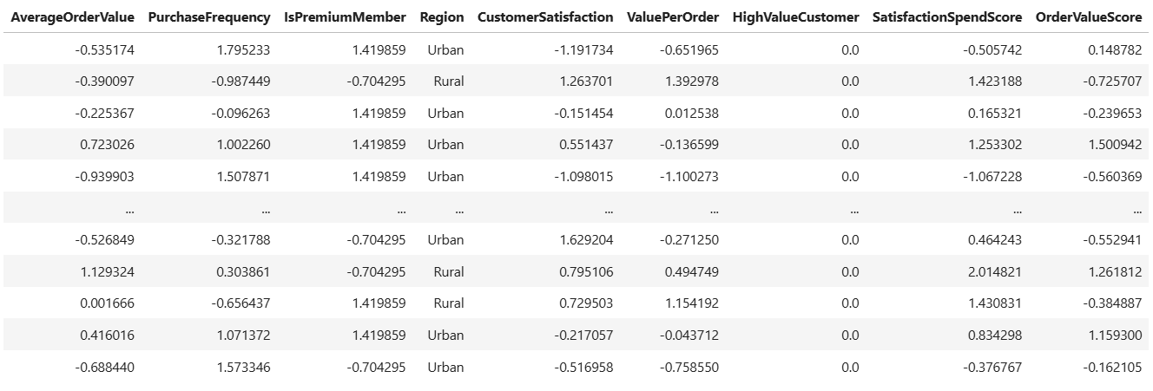

Data Preprocessing
Standardization
Train-Test Split

Slide 6
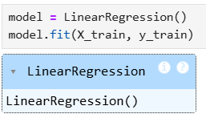

Modeling and Evaluation
Model Training
Evaluation
A linear regression model is trained using selected features to predict Customer Lifetime Value (CLV). The dataset is split into 80% training and 20% testing data. Using Scikit-learn, the model is trained to learn the linear relationships between input features and the target variable. Once trained, it is used to make predictions on the test set.
The performance of the linear regression model is evaluated using the following metrics:
Mean Squared Error (MSE): Measures the average of squared differences between actual and predicted values, giving more weight to larger errors.
Root Mean Squared Error (RMSE): Square root of MSE, making the error interpretable in the same units as the target variable.
R-squared (R²): Represents the proportion of variance in the target variable explained by the model.

Slide 7
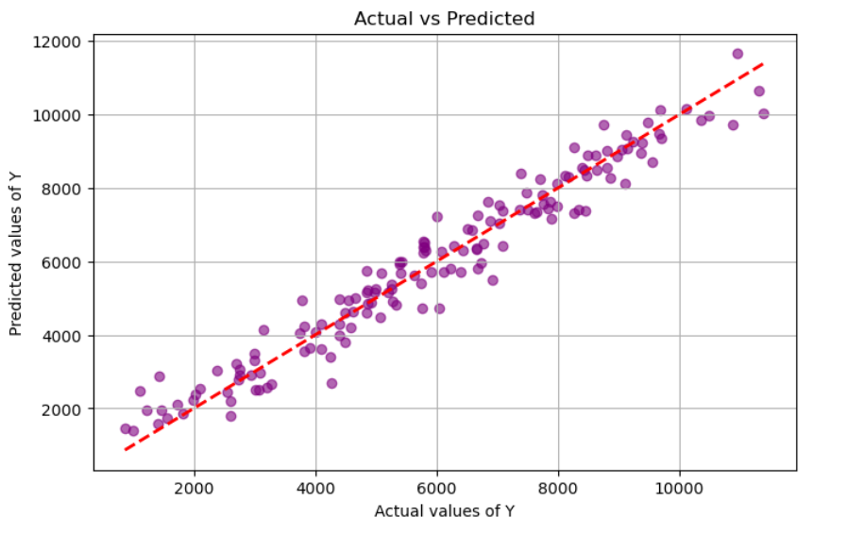
Model Performance Visualization
This plot shows the performance of the linear regression model in predicting Customer Lifetime Value (CLV). Each purple dot represents a customer, comparing actual vs. predicted CLV. The red dashed line indicates perfect predictions. Most points align closely with this line, suggesting the model captures the relationship well and predicts CLV with minimal error.

Slide 8
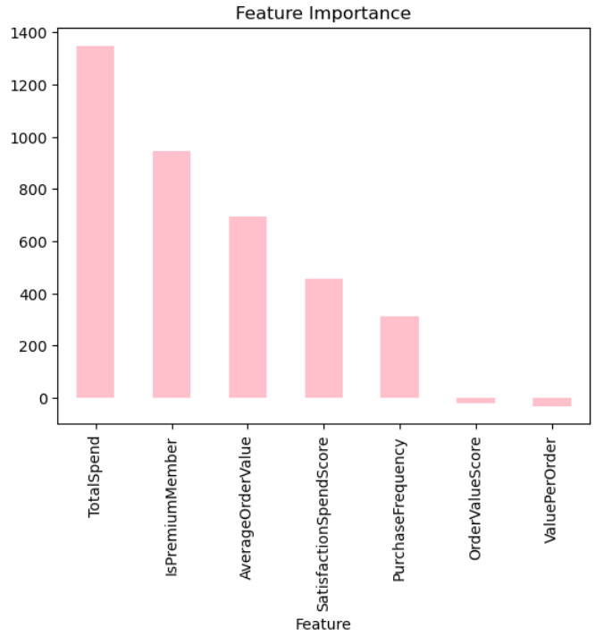
Feature Importance
The model identified the following features as most influential in predicting Customer Lifetime Value (CLV):
TotalSpend – Strongest predictor; directly impacts CLV.
AverageOrderValue – Indicates spending behavior per transaction.
PurchaseFrequency – Reflects customer engagement over time.
SatisfactionSpendScore – Positively correlated with long-term value.
IsPremiumMember – Premium members tend to have higher CLV.

Slide 9
Key Findings
The linear regression model showed strong predictive ability for CLV, with accurate results for most customers.
Preprocessing steps such as outlier removal, feature scaling, and one-hot encoding significantly improved model performance.
Important predictors of CLV included Total Spend, Is Premium Member, and Average Order Value.
Visualizations (e.g., Actual vs Predicted plots) confirmed the model's reliability in capturing core customer behavior patterns.
Conclusion
The linear regression model successfully predicted Customer Lifetime Value with high accuracy and interpretability. Key preprocessing steps and feature selection played a crucial role in model performance. Overall, the model provides valuable insights for customer value analysis.

Slide 10
Instructor: Mr. Saeed
Loan Approval Prediction using Classification
Prepared by: Mishal Nadeem
2023-BSAI-020

Slide 11
Introduction
This project focuses on predicting loan approval using machine learning classification techniques. The dataset is carefully preprocessed by handling missing values, encoding categorical data, and standardizing features. Three models are built and compared: Random Forest, Support Vector Machine (SVM), and a basic Neural Network. The goal is to improve the accuracy and efficiency of loan approvals by identifying key patterns in the data and evaluating each model’s performance using metrics such as accuracy and ROC-AUC. This study highlights the potential of machine learning in supporting financial decision-making.

Slide 12
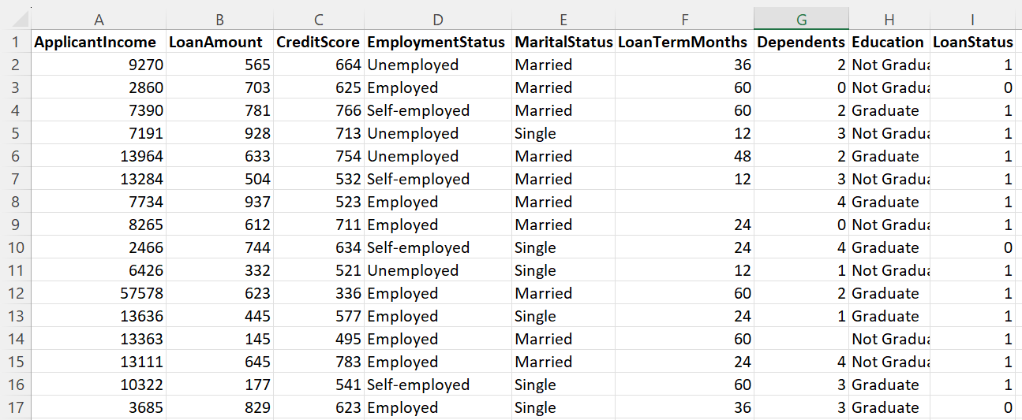
Dataset: Customer Lifetime Value
The dataset contains 1,000 rows and 9 columns, designed to analyze factors that influence loan approval decisions. It is suitable for building predictive models in loan eligibility classification and credit risk assessment. The dataset includes both numerical and categorical variables, covering applicant income, loan amount, credit score, employment status, and education level. The target variable is LoanStatus, indicating whether a loan was approved (1) or rejected (0).

Slide 13
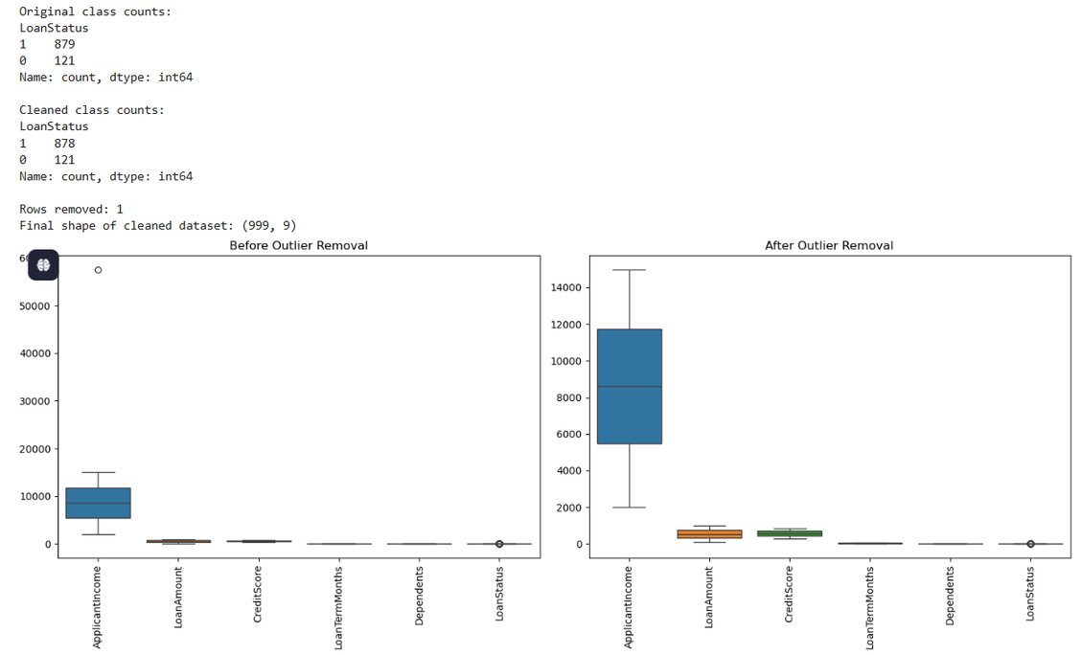
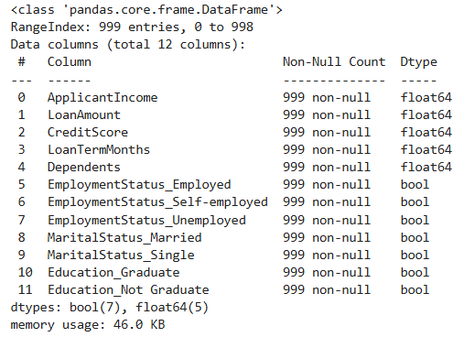
Data Preprocessing
Outlier Removal
One-hot Encoding

Slide 14
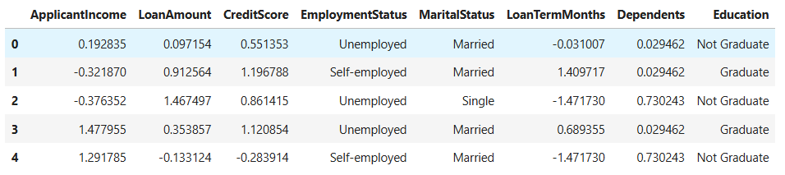
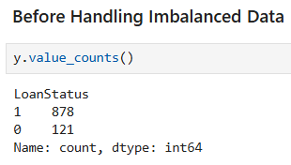
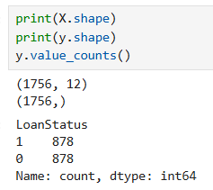

Data Preprocessing
Standardization
Handling Imbalance Data
Train-Test Split
Before
After

Slide 15
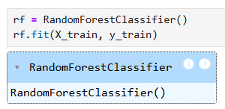
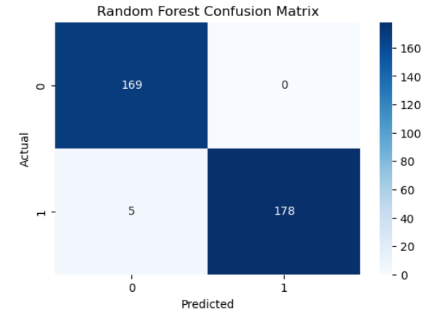
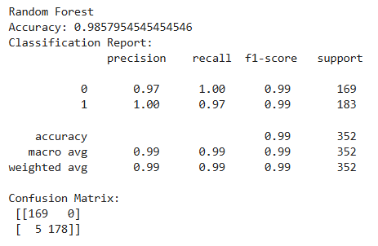
Modeling and Evaluation (Random Forest)
Model Training
Confusion Matrix
Classification Report

Slide 16

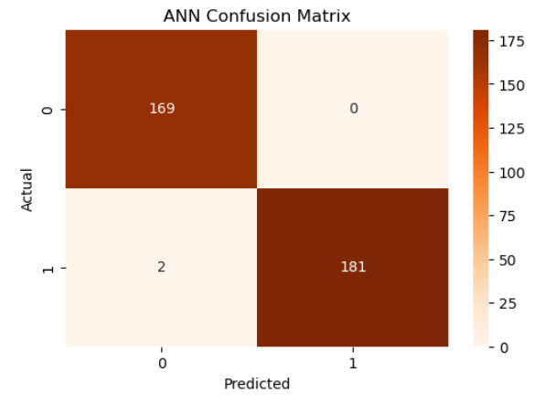

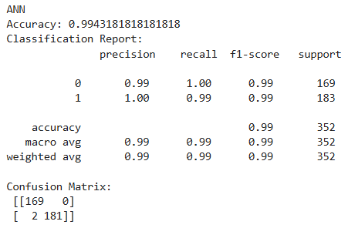
Modeling and Evaluation (ANN)
Model Training
Confusion Matrix
Classification Report

Slide 17
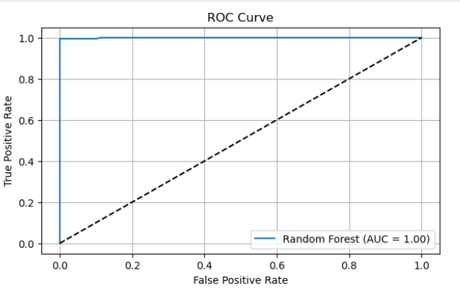
ROC Curve and AUC
ROC Curve shows how well your model separates the positive and negative classes at various thresholds.
AUC gives you a single number summarizing the model’s overall performance.
ROC Curve
AUC

Slide 18
Key Findings
Data preprocessing (handling missing values, encoding, and scaling) significantly improved model readiness and performance.
Applying SMOTE effectively addressed class imbalance, leading to fairer and more accurate classification results.
Random Forest and Neural Network outperformed SVM in terms of accuracy, precision, recall, and ROC-AUC.
Key features influencing loan approval included Credit Score, Applicant Income, and Loan Amount.
Visual tools like the confusion matrix and ROC curve helped evaluate and compare model performance comprehensively.
Conclusion
This project successfully developed a machine learning pipeline to predict loan approvals using classification models. Preprocessing and class balancing were critical to model success. Among the tested models, Random Forest and Neural Network showed robust performance. The findings demonstrate that machine learning can enhance the accuracy, fairness, and efficiency of loan approval systems, offering financial institutions data-driven decision support for faster and more reliable loan processing.

Slide 19
Thankyou

